Slide 1
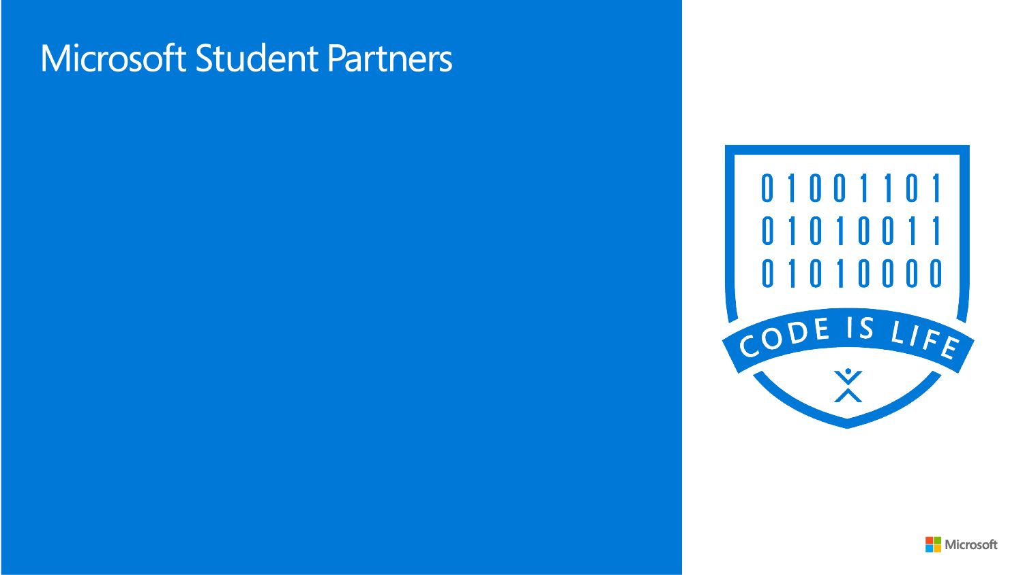
HacktoberFest

Slide 2



About me
Kanishk Gupta
Microsoft Student Partner
Vice Chair @ ACM Student Chapter
@gKanishk
@gKanishk
gkanishk.github.io

Slide 3
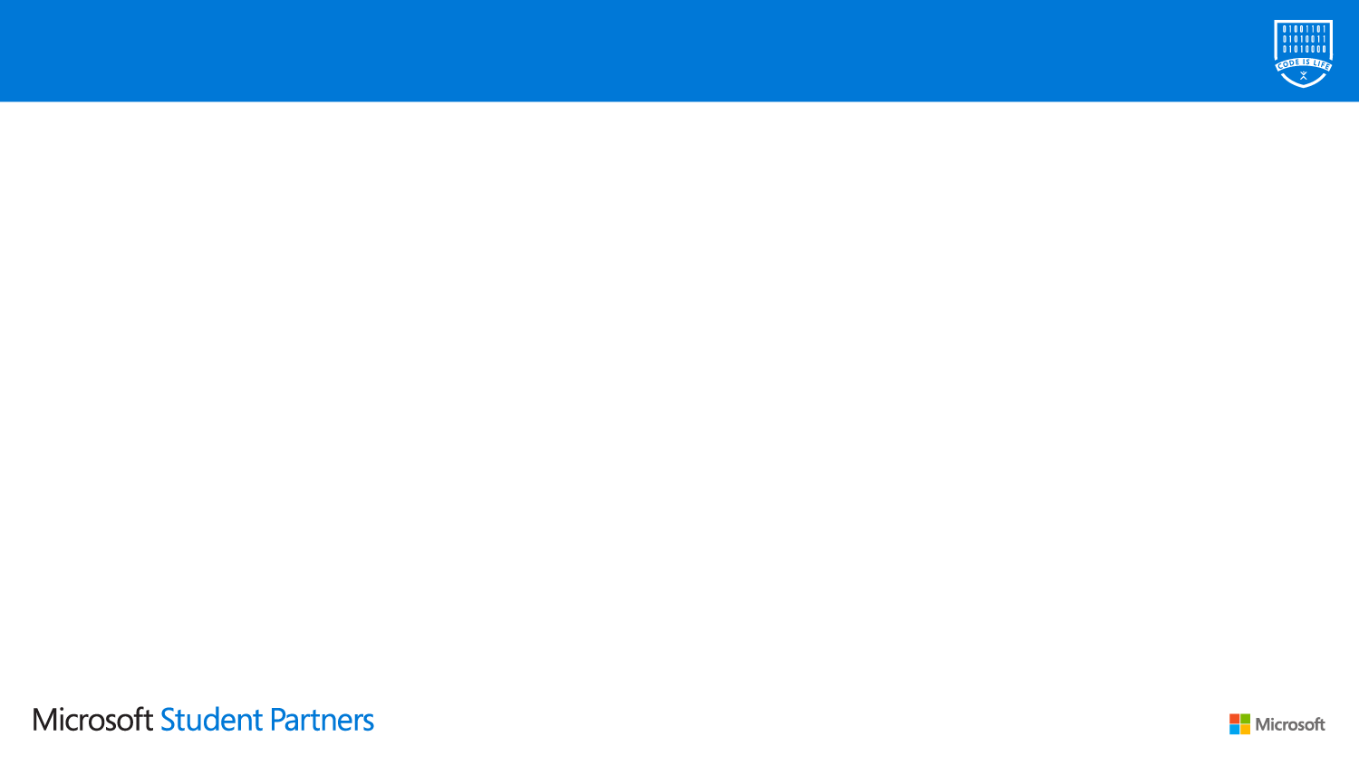
What is Hacktoberfest?
An open source challenge.
Organized every year during month of October.
Open for any developer, student or any open source enthusiast.
Organized in collaboration with GitHub and Digital Ocean.
After completion we get a limited-edition t-shirt from GitHub.

Slide 4
What You Need to do?

Slide 5
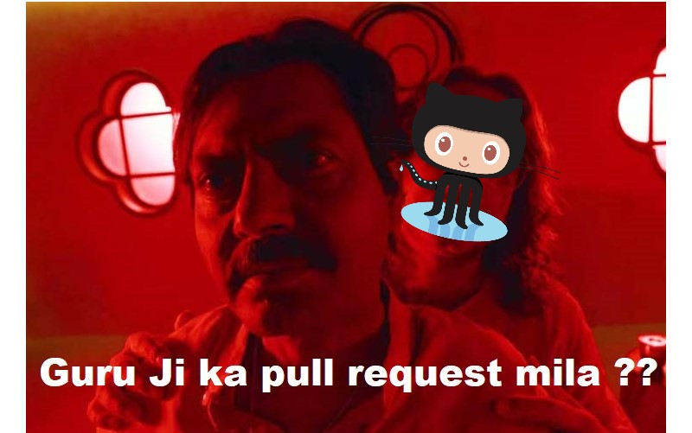
Four Pull Request is all you need to do!

Slide 6
Steps to make a pull request:
Select a project.
Best way to contribute in an open source project is “Documentation” as a beginner.
Search for repositories with “HacktoberFest” tag as they usually have issues and are made for HacktoberFest.
You can contribute in any repository so chill let’s start.

Slide 7

Selected a repo now Let’s clone it.

Slide 8
After cloning we must make changes in our local repository which we have forked.
Simply do changes which you feel is relevant and then commit the changes.

Slide 9
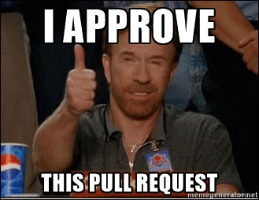
And finally “PULL REQUEST”
Create a pull request add the description which includes the changes you have made.
That’s all you need to do
Wait for your pull request to be accepted.

Slide 10
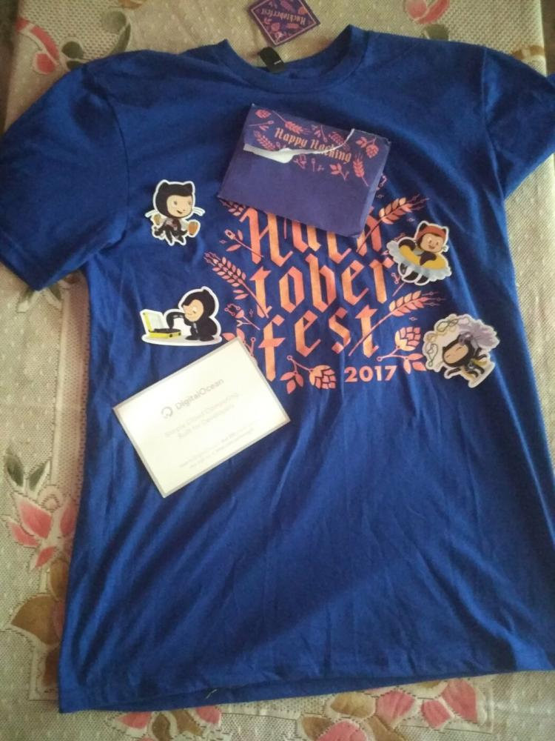
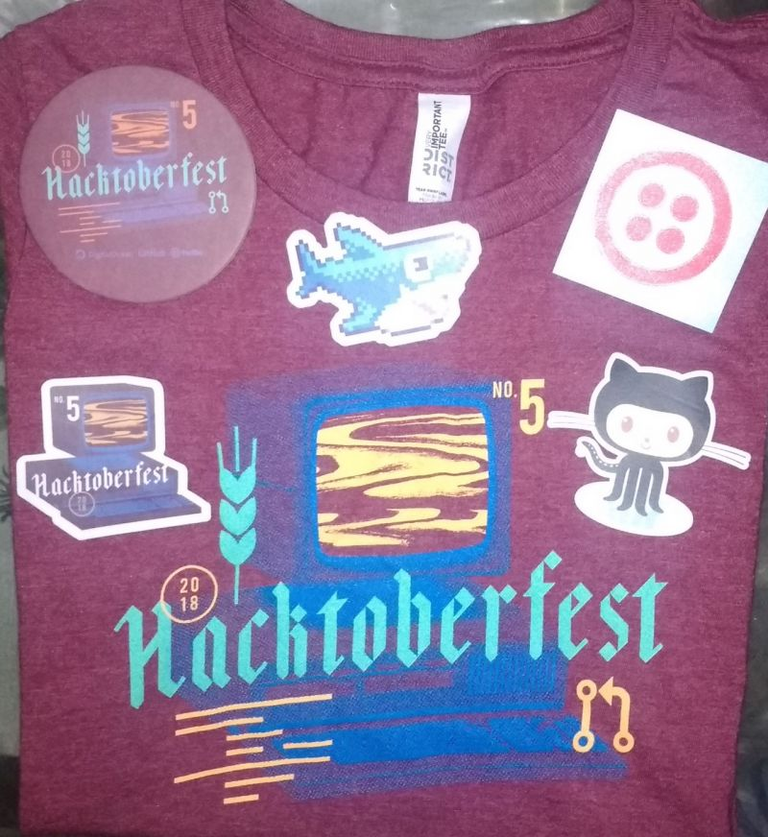
Swags from last year

Slide 11
